Slide 1
P H O B I A
Shova Akter
ID: 011221033
Sheikh Shakib Hossain
ID: 011221031
Afrina Hossain Riana
ID: 011221032
Md. Rowshon Hassan
ID: 011221037

Slide 2


Slide 3


Slide 4
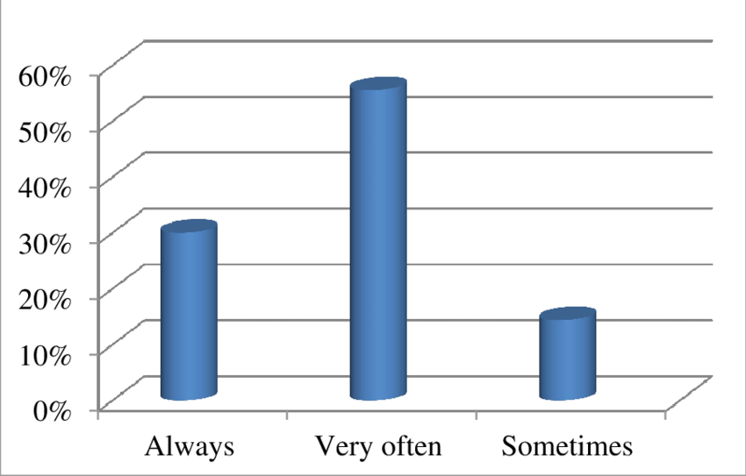

Slide 5
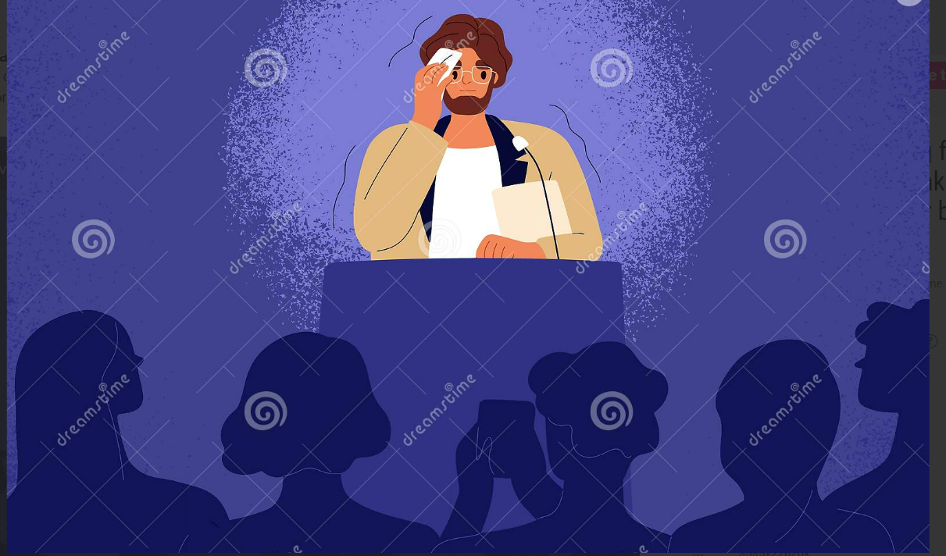

Slide 6
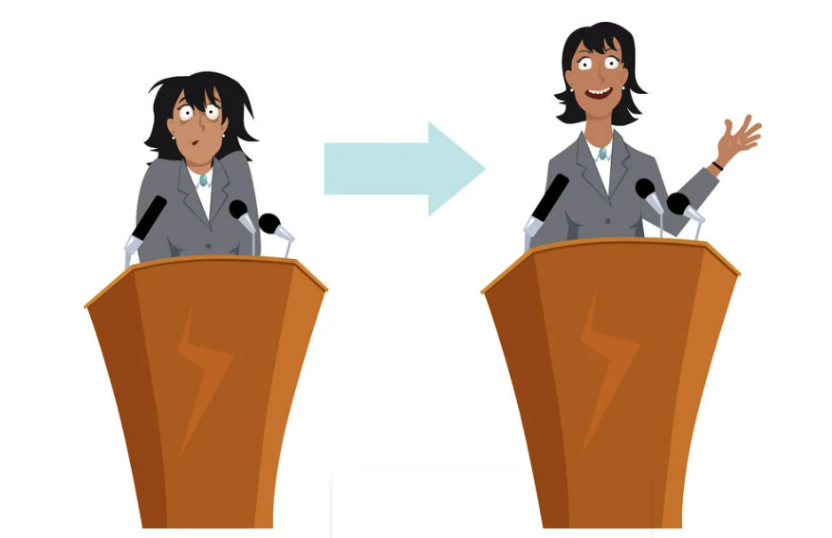

Slide 7
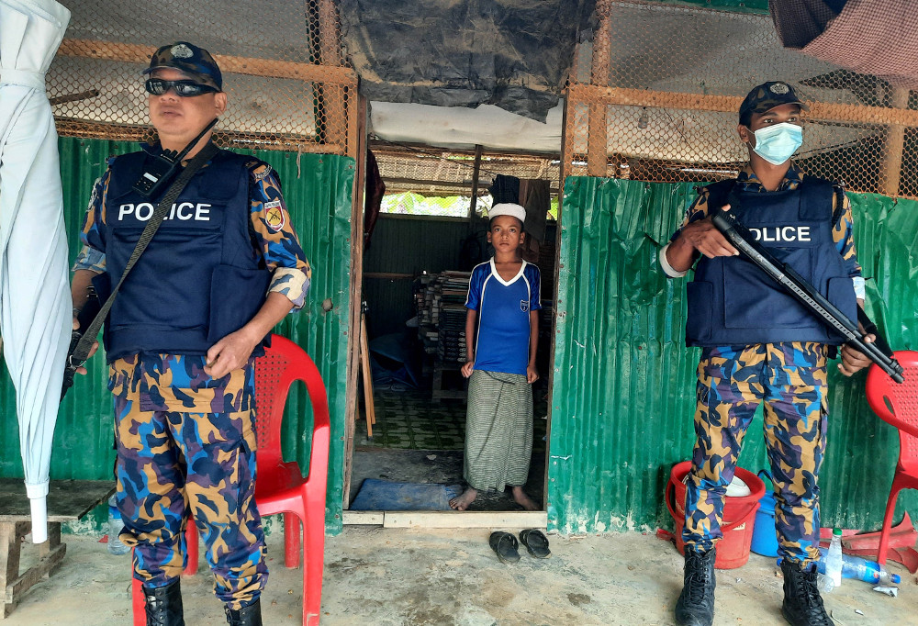
C A P I O P H O B I A

Slide 8
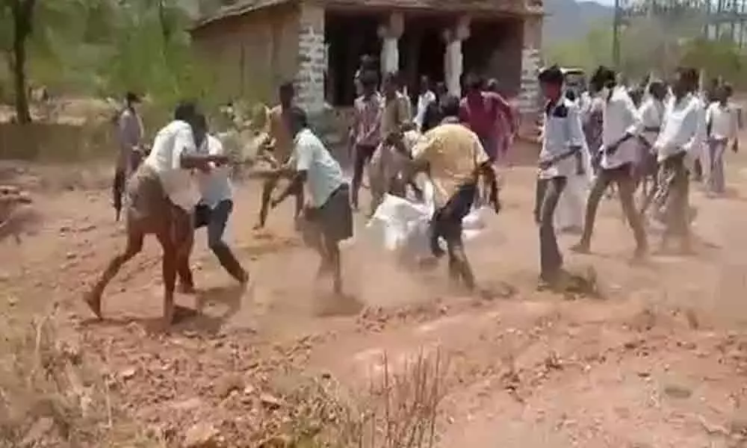

Slide 9
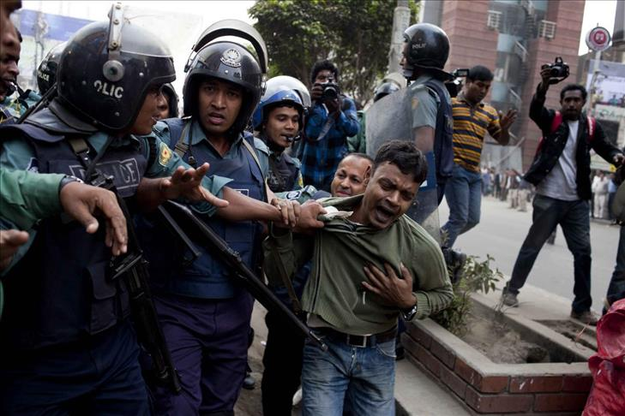

Slide 10

If you don’t eat
the policeman will
take you away

Slide 11
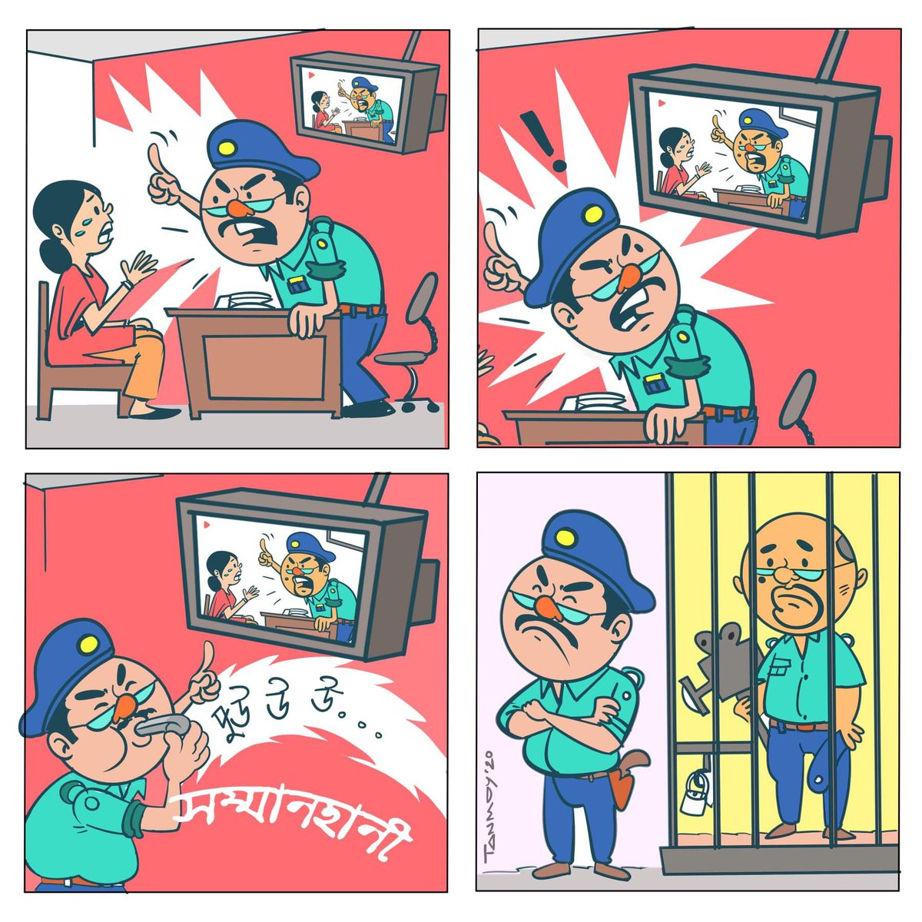

Slide 12


Slide 13
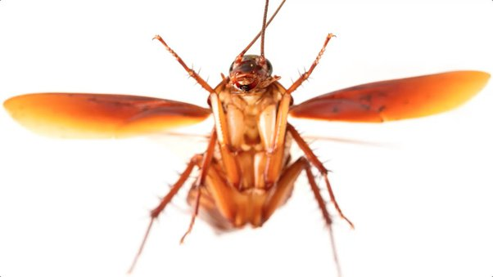
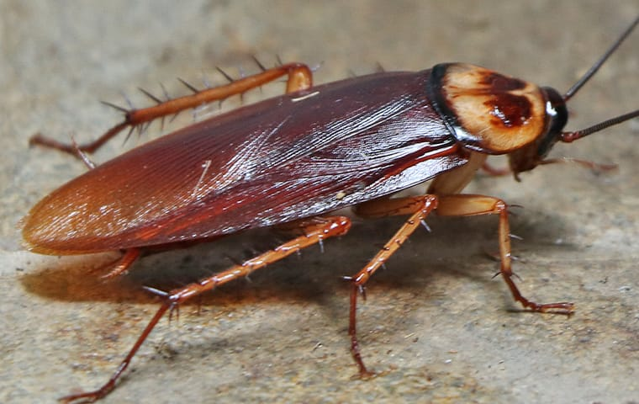

Slide 14


Slide 15
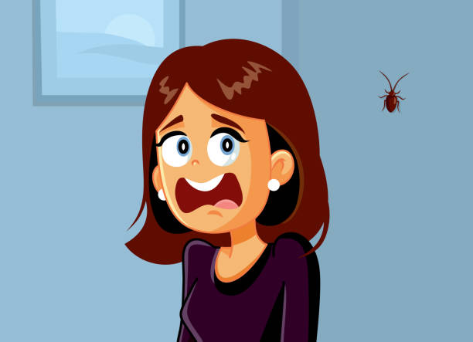
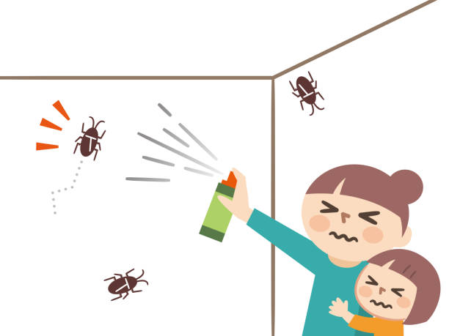

Slide 16


Slide 17
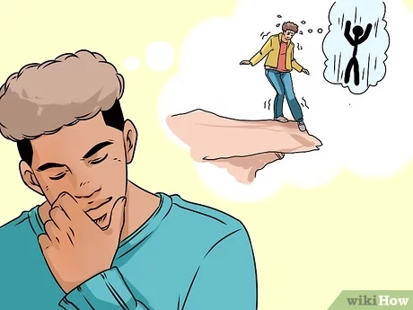

Slide 18
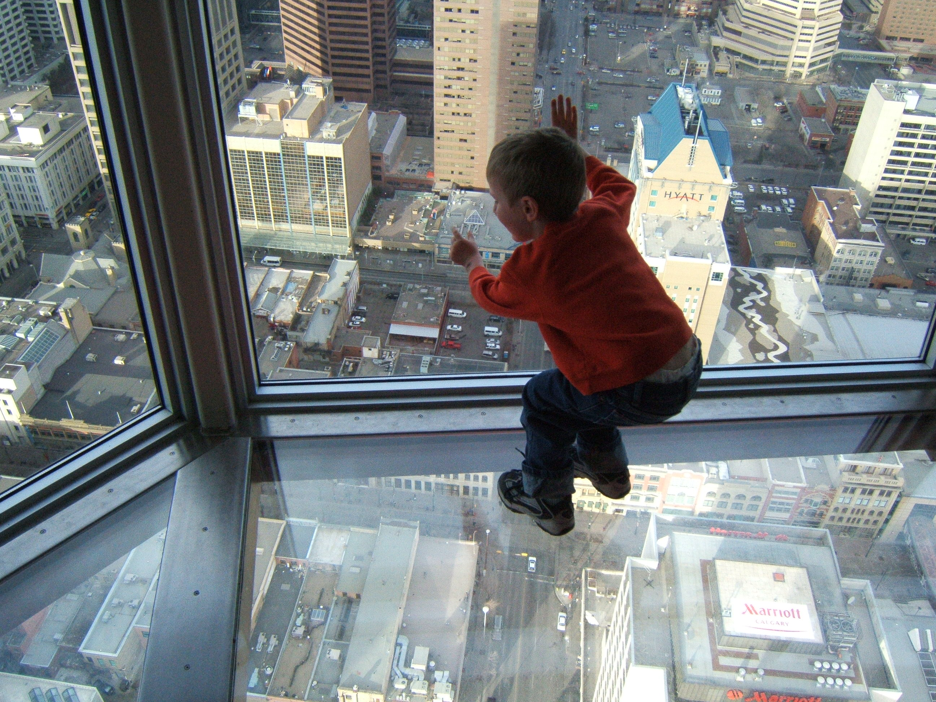

Slide 19
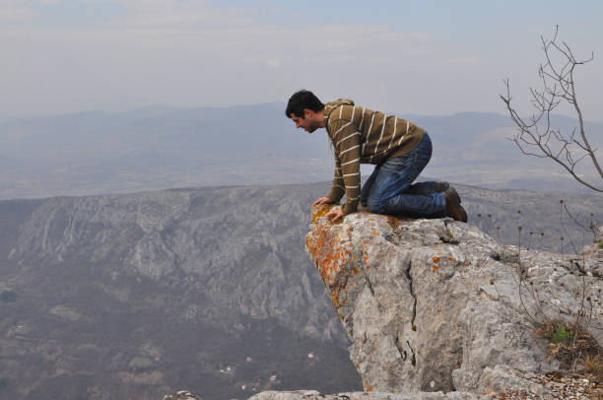

Slide 20


Slide 21


Slide 22


